Slide 1
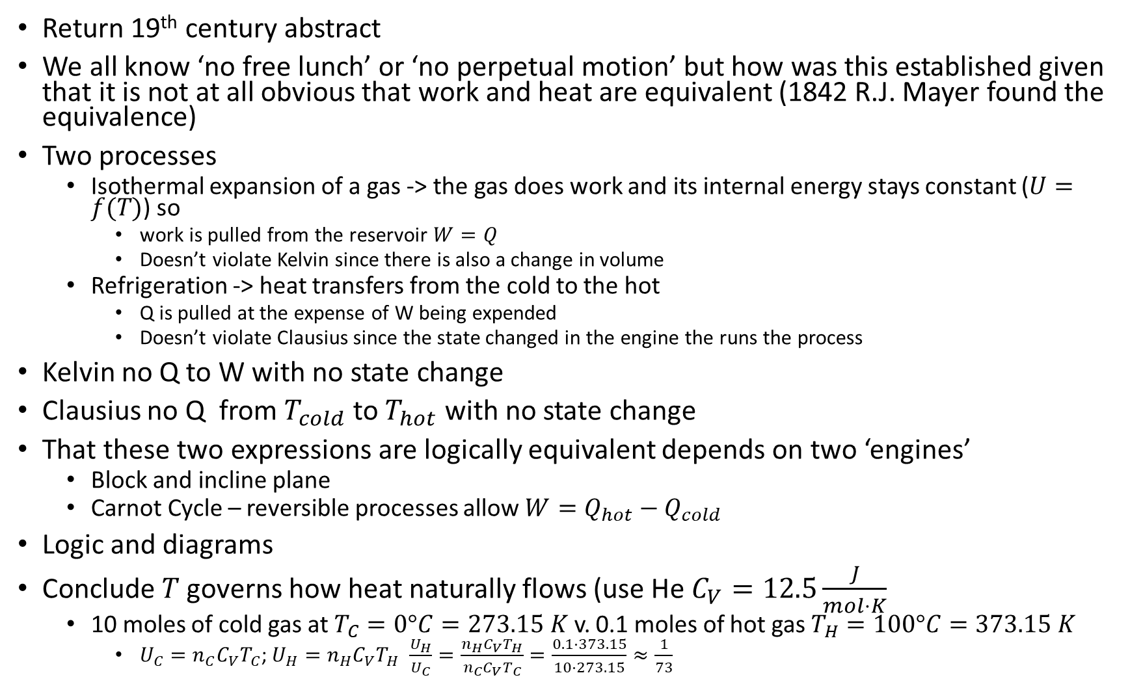
Return 19th century abstract
We all know ‘no free lunch’ or ‘no perpetual motion’ but how was this established given that it is not at all obvious that work and heat are equivalent (1842 R.J. Mayer found the equivalence)
Two processes
Isothermal expansion of a gas -> the gas does work and its internal energy stays constant ($U=f(T)$) so
work is pulled from the reservoir $W=Q$
Doesn’t violate Kelvin since there is also a change in volume
Refrigeration -> heat transfers from the cold to the hot
Q is pulled at the expense of W being expended
Doesn’t violate Clausius since the state changed in the engine the runs the process
Kelvin no Q to W with no state change
Clausius no Q from $T_{cold}$ to $T_{hot}$ with no state change
That these two expressions are logically equivalent depends on two ‘engines’
Block and incline plane
Carnot Cycle – reversible processes allow $W=Q_{hot}−Q_{cold}$
Logic and diagrams
Conclude $T$ governs how heat naturally flows (use He $C_{V}=12.5\frac{J}{mol⋅K}$
10 moles of cold gas at $T_{C}=0°C=273.15 K$ v. 0.1 moles of hot gas $T_{H}=100°C=373.15 K$
$U_{C}=n_{C}C_{V}T_{C}$; $U_{H}=n_{H}C_{V}T_{H}$ $\frac{U_{H}}{U_{C}}=\frac{n_{H}C_{V}T_{H}}{n_{C}C_{V}T_{C}}=\frac{0.1⋅373.15}{10⋅273.15}≈\frac{1}{73}$

Slide 2



$$W$$
$$Q$$

Slide 3


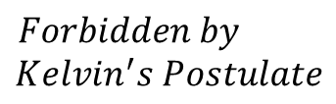


$$Forbidden by$$
$$Kelvin^{′}s Postulate$$
$$P$$
$$𝒜$$
$$W$$
$$T$$
$$V$$

Slide 4

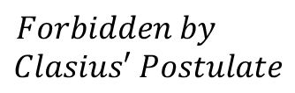










$$Forbidden by$$
$$Clasius′ Postulate$$
$$P$$
$$𝒜$$
$$P$$
$$ℬ$$
$$Q_{T}$$
$$T$$
$$T$$
$$T_{H}$$
$$T_{C}$$
$$V$$
$$V$$

Slide 5










!Kelvin => !Clasius
$$P$$
$$𝒜$$
$$P$$
$$ℬ$$
$$W$$
$$Q_{W}$$
$$T$$
$$T$$
$$T_{H}$$
$$T_{C}$$
$$V$$
$$V$$

Slide 6


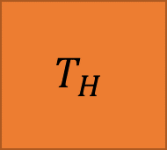

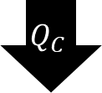

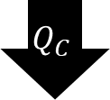
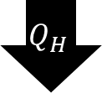
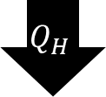
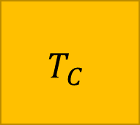


$$T_{H}$$
$$T_{H}$$
$$Q_{H}$$
$$System$$
$$Q_{H}$$
$$W$$
$$System$$
$$Q_{C}$$
$$W=Q_{H}−Q_{C}$$
$$T_{C}$$
$$Q_{C}$$
$$T_{C}$$

Slide 7








$$P$$
$$𝒜$$
$$Q_{in}$$
$$ℬ$$
$$𝒟$$
$$Q_{out}$$
$$𝒞$$
$$V$$

Slide 8




Isothermal
Expansion
Adiabatic
Expansion
Isothermal Compression
Adiabatic
Compression
$$𝒜$$
$$ℬ$$
$$𝒞$$
$$𝒟$$

Slide 9

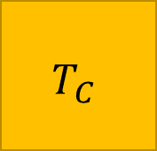





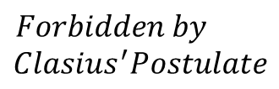



$$T_{H}$$
$$Q_{H}$$
$$System$$
$$Forbidden by$$
$$Clasius^{′}Postulate$$
$$W$$
$$T_{C}$$
$$T_{H}$$
$$Q_{friction}$$
$$Q_{C}$$
$$Q_{C}$$
$$T_{C}$$

Slide 10




$$P$$
$$P$$
$$V$$
$$V$$

Slide 11
$$P$$
$$P$$
$$V$$
$$V$$

Slide 12








!Kelvin => !Clasius
$$P$$
$$𝒜$$
$$P$$
$$ℬ$$
$$W$$
$$Q_{W}$$
$$T$$
$$T$$
$$T_{H}$$
$$T_{C}$$
$$V$$
$$V$$

Slide 13



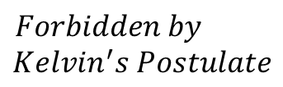


$$isothermal$$
$$surface$$
$$Forbidden by$$
$$Kelvin^{′}s Postulate$$
$$P$$
$$𝒜$$
$$W$$
$$T$$
$$V$$

Slide 14






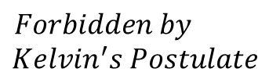




$$Forbidden by$$
$$Kelvin^{′}s Postulate$$
$$P$$
$$𝒜$$
$$W$$
$$T$$
$$V$$
$$P$$
$$𝒜$$
$$P$$
$$ℬ$$
$$W$$
$$Q_{W}$$
$$T$$
$$T$$
$$T_{H}$$
$$T_{C}$$
$$V$$
$$V$$

Slide 15

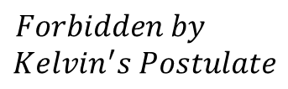
$$isothermal$$
$$surface$$
$$Forbidden by$$
$$Kelvin^{′}s Postulate$$
$$P$$
$$𝒜$$
$$W$$
$$T$$
$$V$$
$$P$$
$$𝒜$$
$$P$$
$$ℬ$$
$$W$$
$$Q_{W}$$
$$T$$
$$T$$
$$T_{H}$$
$$T_{C}$$
$$V$$
$$V$$

